Slide 1
Camera Model

Slide 2
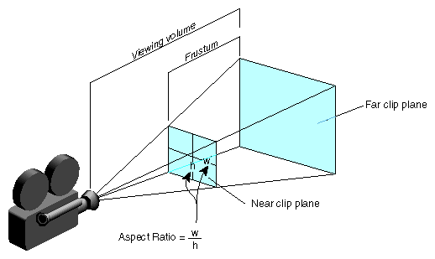
Camera Model

Slide 3
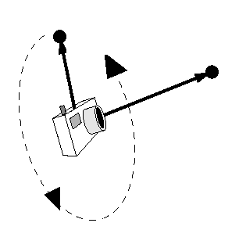
Camera Model
The look vector indicates the direction in which the camera is pointing
The up vector determines how the camera is rotated
For example, is the camera held vertically or horizontally
Projection of up vector
Up vector
Look vector
Position

Slide 4
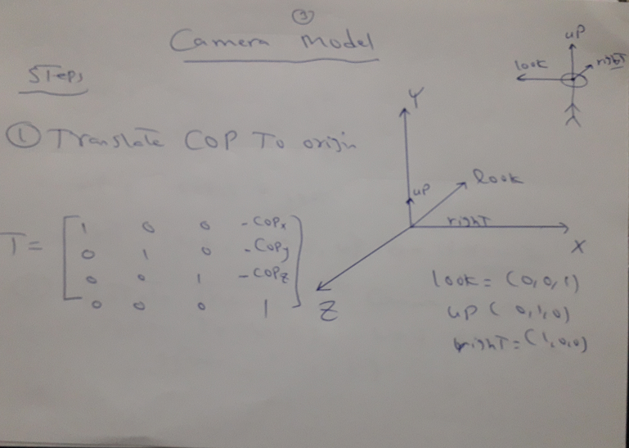
Camera Model

Slide 5
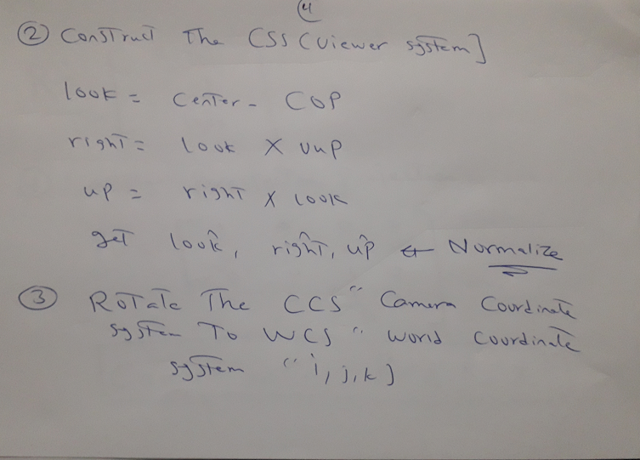
Camera Model

Slide 6
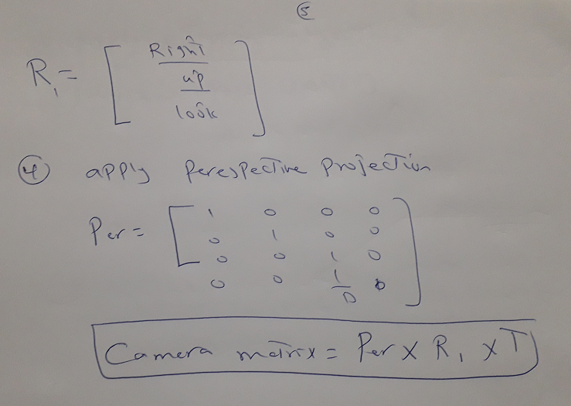
Camera Model

Slide 7
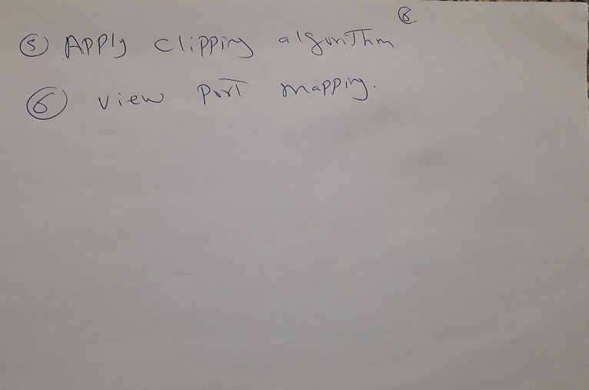
Camera Model

Slide 8
Example
What is the projection of the point (12, 8, 6) at the camera view plane if the camera parameters are: COP=(3, 2, 2), VPN=(3, 4, 0), VUP=(1, 1, 1), D=4 if:
- Parallel projection is used
- Perspective projection is used

Slide 9
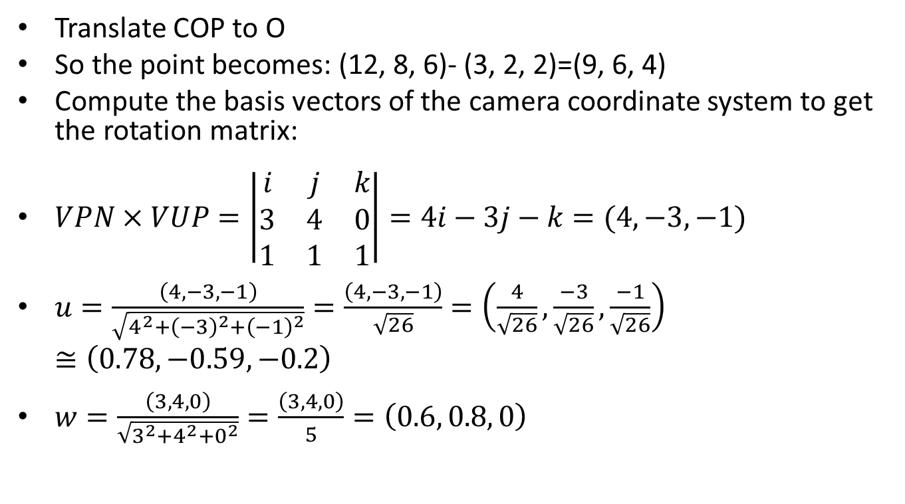
Example
Translate COP to O
So the point becomes: (12, 8, 6)- (3, 2, 2)=(9, 6, 4)
Compute the basis vectors of the camera coordinate system to get the rotation matrix:
$VPN×VUP=\left|\begin{matrix}i & j & k \\ 3 & 4 & 0 \\ 1 & 1 & 1\end{matrix}\right|=4i−3j−k=(4,−3,−1)$
$u=\frac{\left(4,−3,−1\right)}{\sqrt{4^{2}+{\left(−3\right)}^{2}+{\left(−1\right)}^{2}}}=\frac{\left(4,−3,−1\right)}{\sqrt{26}}=\left(\frac{4}{\sqrt{26}},\frac{−3}{\sqrt{26}},\frac{−1}{\sqrt{26}}\right)≅\left(0.78,−0.59,−0.2\right)$
$w=\frac{\left(3, 4, 0\right)}{\sqrt{3^{2}+4^{2}+0^{2}}}=\frac{\left(3, 4, 0\right)}{5}=\left(0.6, 0.8, 0\right)$

Slide 10
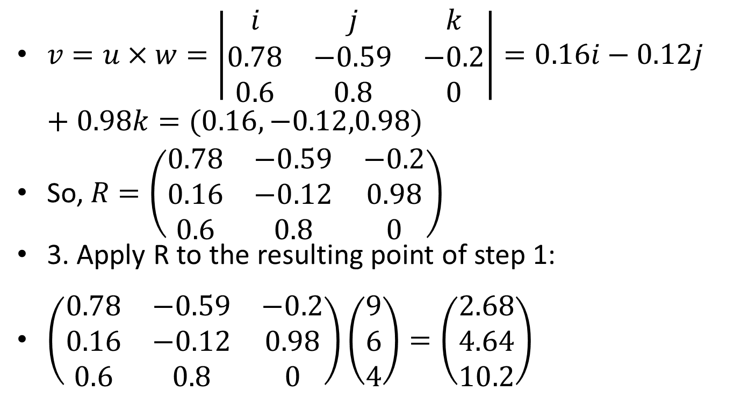
Example
$v=u×w=\left|\begin{matrix}i & j & k \\ 0.78 & −0.59 & −0.2 \\ 0.6 & 0.8 & 0\end{matrix}\right|=0.16i−0.12j+0.98k=(0.16,−0.12,0.98)$
So, $R=\left(\begin{matrix}0.78 & −0.59 & −0.2 \\ 0.16 & −0.12 & 0.98 \\ 0.6 & 0.8 & 0\end{matrix}\right)$
3. Apply R to the resulting point of step 1:
$\left(\begin{matrix}0.78 & −0.59 & −0.2 \\ 0.16 & −0.12 & 0.98 \\ 0.6 & 0.8 & 0\end{matrix}\right)\left(\begin{matrix}9 \\ 6 \\ 4\end{matrix}\right)=\left(\begin{matrix}2.68 \\ 4.64 \\ 10.2\end{matrix}\right)$

Slide 11
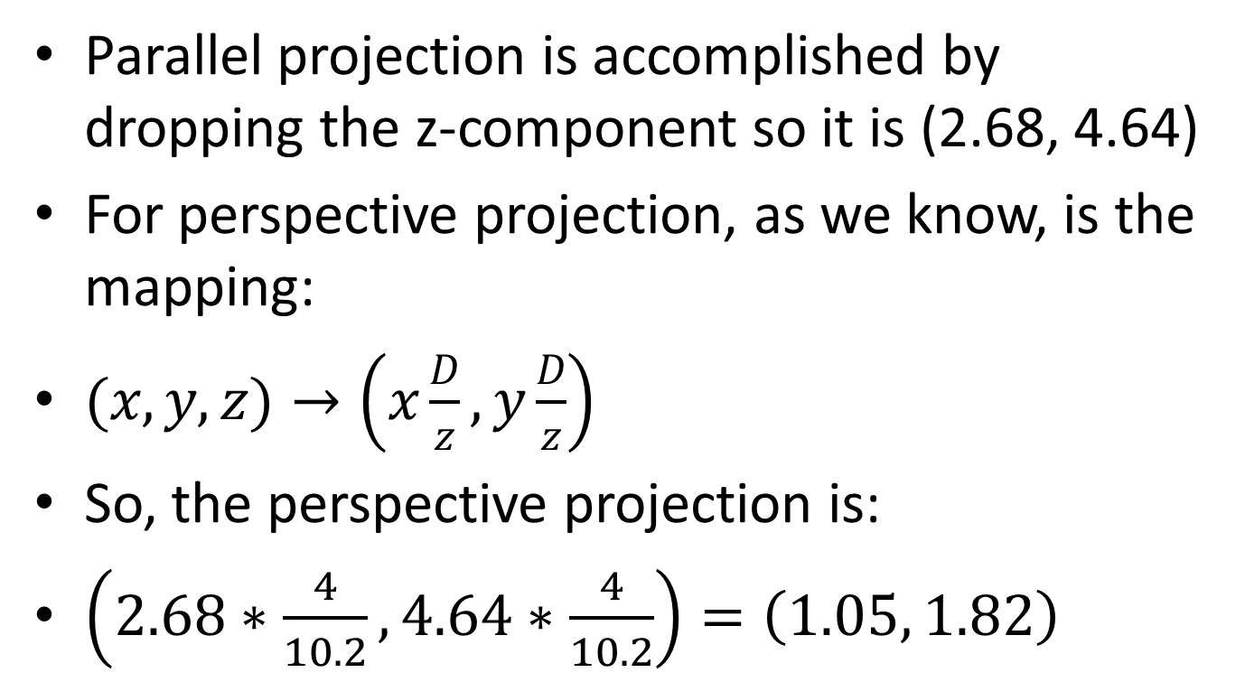
Example
Parallel projection is accomplished by dropping the z-component so it is (2.68, 4.64)
For perspective projection, as we know, is the mapping:
$(x,y,z)→\left(x\frac{D}{z},y\frac{D}{z}\right)$
So, the perspective projection is:
$\left(2.68∗\frac{4}{10.2},4.64∗\frac{4}{10.2}\right)=\left(1.05, 1.82\right)$

Slide 12
Matrix based
1. translate =
1 0 0 -3
0 1 0 -2
0 0 1 -2
0 0 0 1
2. Rotation =
0.7800 -0.5900 -0.2000 0
0.1600 -0.1200 0.9800 0
0.6000 0.8000 0 0
0 0 0 1.0000

Slide 13
Matrix based
Perespective =
1.0000 0 0 0
0 1.0000 0 0
0 0 1.0000 0
0 0 0.2500 0
Final matrix(Perespective )= Perespective *Rotation*Translation
0.7800 -0.5900 -0.2000 -0.7600
0.1600 -0.1200 0.9800 -2.2000
0.6000 0.8000 0 -3.4000
0.1500 0.2000 0 -0.8500

Slide 14
Matrix based
Point After Rotation=Final*Point
Result =
2.6800
4.6400
10.2000
2.5500
Divide by forth element as it should be 1
Then Result=
1.0510
1.8196
4.0000
1.0000

Slide 15
Matrix based
Parallel matrix =
1 0 0 0
0 1 0 0
0 0 0 0
0 0 0 1
Final result to parallel: parallel *Rotation *Translation
0.7800 -0.5900 -0.2000 -0.7600
0.1600 -0.1200 0.9800 -2.2000
0 0 0 0
0 0 0 1.0000

Slide 16
Matrix based
Result (Parallel)
2.6800
4.6400
0
1.0000

